Slide 1
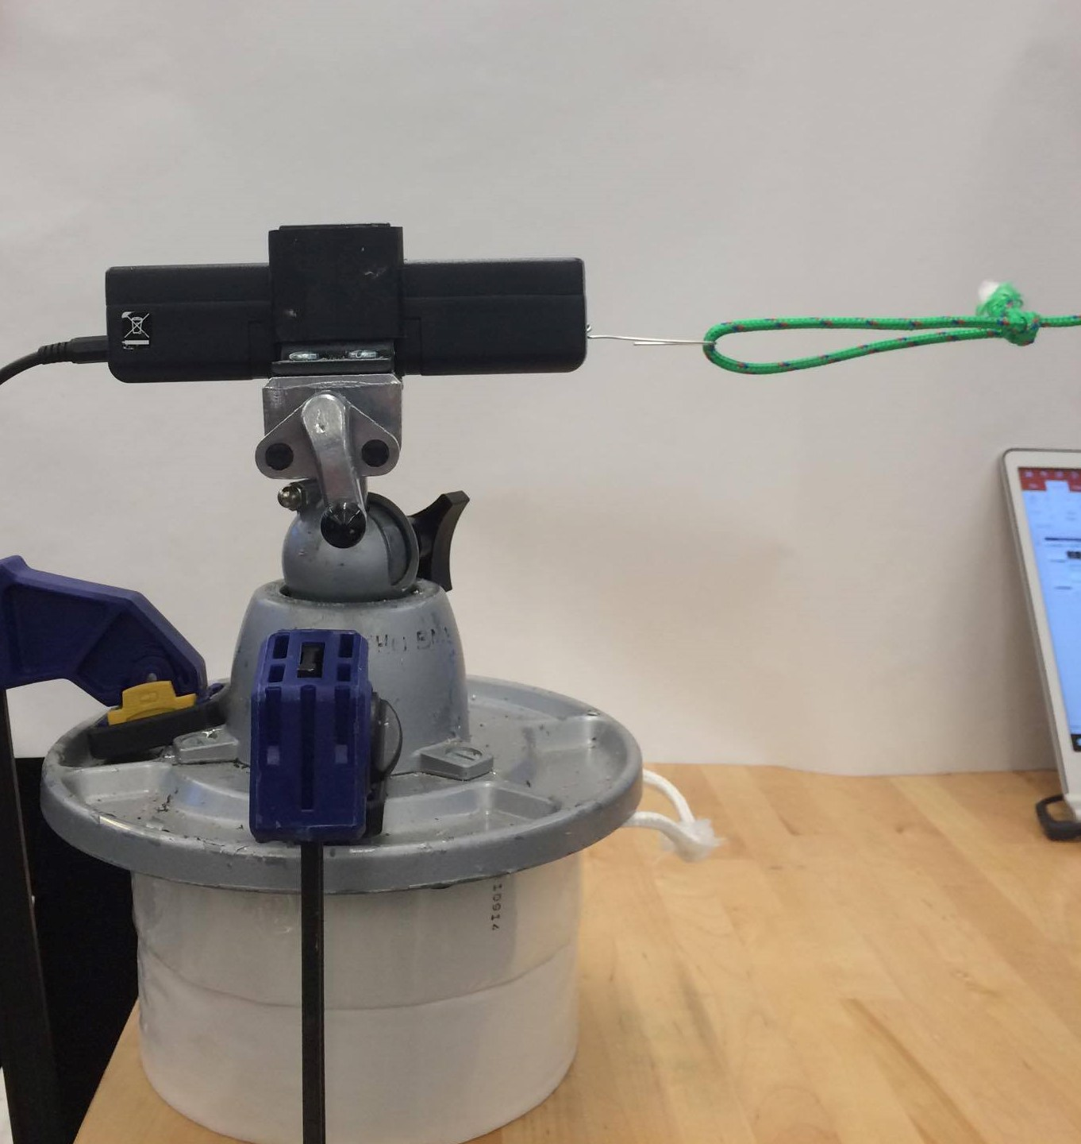
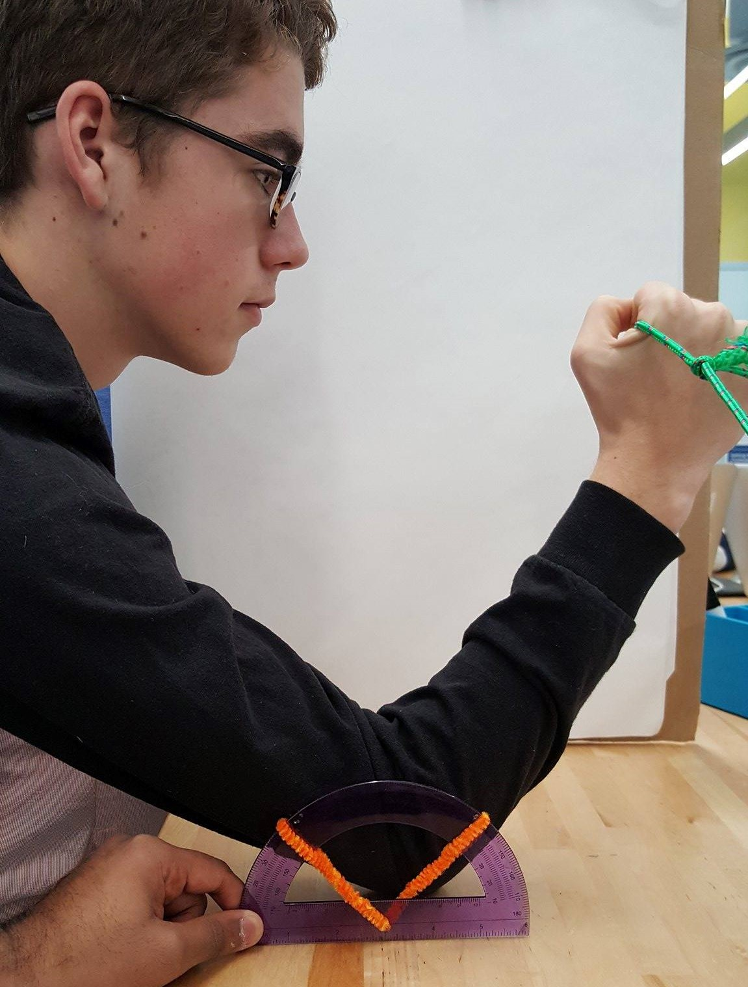
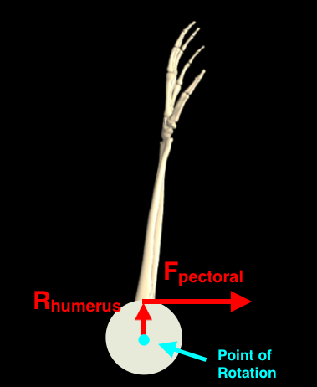
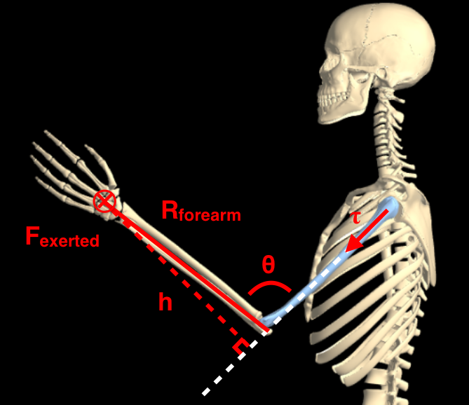
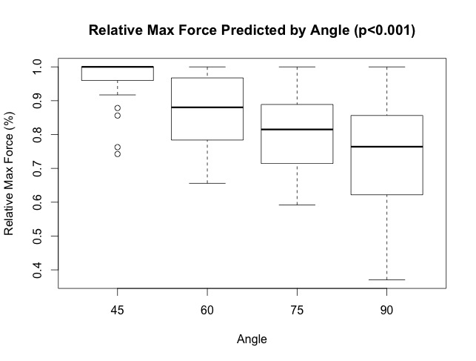
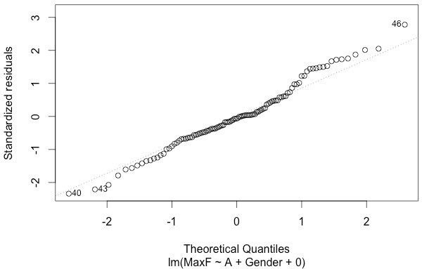
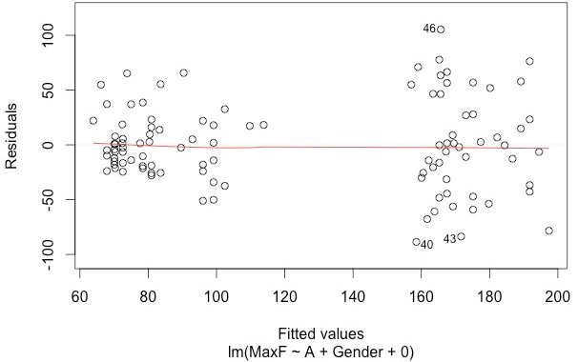

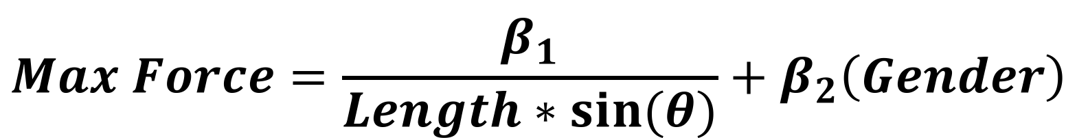
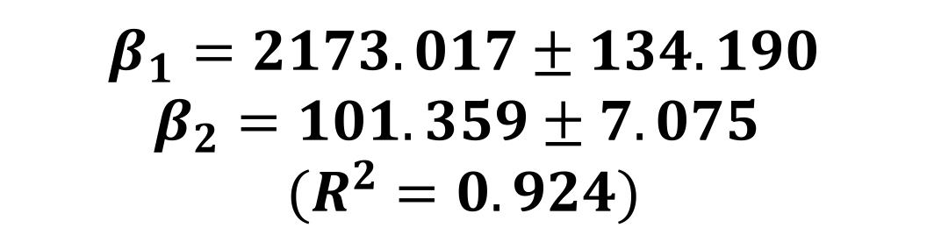

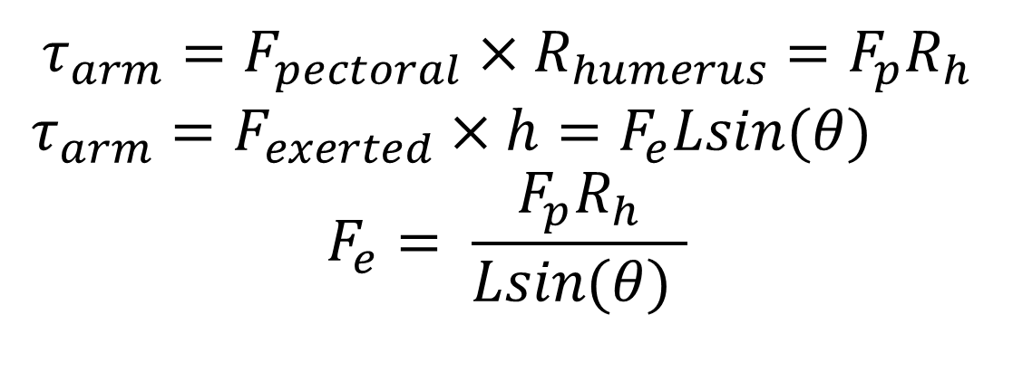
Brains Behind the Brawn: An Analysis of Arm Wrestling
Faculty Sponsor: Dr. Feilim Mac Gabhann
Lab Manager: Rohith Bhethanabotla
Dan O’Brien, Akash Chaurasia, Jung Min Lee, Sun Jay Yoo, Alex Glavin
ABSTRACT
HYPOTHETICAL MODEL
EXPERIMENTAL DESIGN
DISCUSSION
Positioning and physical properties are important factors that determine success in an arm wrestling match. Widely used techniques such as pulling the arm closer to the body and bending the wrist indicate that there are certain postures that allow a person to exert the maximum amount of force. Using a simple arm wrestling model, we were able to conclude that among the angles measured, 45° was the most optimal angle for maximizing force. The results also showed that with reduced elbow angle and arm length, the force exerted increased. While the relative force for each angle was approximately the same for both genders, males were shown to be 49% stronger than females. With these results, we were able to create a mathematical model that would predict the maximum force a person can exert, using the person’s forearm length, angle, and gender.
$$τ_{arm}=F_{pectoral}×R_{humerus}=F_{p}R_{h}$$
$τ_{arm}=F_{exerted}×h=F_{e}Lsin\left(θ\right)$
$$F_{e}= \frac{F_{p}R_{h}}{Lsin(θ) }$$
$$(1)$$
(2)
(3)
Our findings motivated a predictive model that combined our mathematical model with a binary gender term, seen below. In interpreting our results, it is necessary to consider biological restrictions, especially for smaller angles. For example, our model predicts near infinite force exerted at near zero angles, however the physical volume of tissue restricts the range of potential angles.
Sources of Error:
Angled strain on force sensor
Muscle fatigue
Variation of stance and body position
Non-random sampling
Repetition of this experiment would mandate more standardization in the positions of subjects as well as more subjects.
Force Sensor
Forearm Angle
Figure 2.1 - Device Setup Sideview
Figure 2.2 - Arm Sideview
Figure 1.1 - Free Body Diagram of Humerus
Figure 1.2 - Free Body Diagram of Humerus
EXPERIMENTAL RESULTS
BACKGROUND
Similar Average Force Normalized to the Maximum Force for both Males and Females (p = 0.66)
CONCLUSIONS
Arm wrestling is a simple activity often used as a measure to compare strength between two or more people, but there are more factors involved than pure strength. Oftentimes, strength is not the only determining factor for success. Posture and technique can impact the amount of strength one can exert. There are several known factors that can help vanquish an opponent. These include: keeping the elbow close to the body, pulling the hand towards the shoulder, bending the wrist inwards (hooking), and leaning in towards the opponent.
In this project, a simplified model of the arm wrestling system was used to determine the impact of arm angle and arm length on the force a person can exert. Our model assumed 1) the force applied on the arm comes only from the pectoral muscle, 2) motion of the arm is in a single axis, 3) one point of attachment for the pectoral muscle, and 4) the model is static and the angle between the arm and the horizontal was maintained at 45°.
Based upon previous studies^{[1,2]}, we predicted that males would be stronger than females, by about 150%. Additionally by our mathematical model, both shorter forearm length and smaller angle would increase the force generated by equivalent torque in accordance to eq (3).
Relative Max Force Predicted by Angle (p < 0.0001)
Our data gave strong evidence supporting our hypotheses:
Males are significantly stronger than females by approximately 49% .
Reduced arm angle and forearm length increase force exerted.
The following equation best models the force exerted:
$$Max Force=\frac{β_{1}}{Length∗sin⁡(θ)}+β_{2}\left(Gender\right)$$
$β_{1}=2173.017±134.190$
$β_{2}=101.359±7.075$
$(R^{2}=0.924)$
(°)
Figure 3.2 - The maximum value for each person was used to normalize each person to account for the difference in raw strength. 7 of the 12 of the males and 10 of the 14 of the females had a max at 45 degrees. The large p-value of 0.66 indicts no difference between males and females. The value at 45 degrees was 28.6% larger for males and 35.6% for females than the value for 90 degrees which is within 9.1% and 4.2% of the expected value of 1.414.
Figure 3.1 - Boxplots of relative max force for each of the four angles tested, with a p-value tested. With p<0.05, it can be concluded with an ANOVA test that at least one of the angles have a significantly different average relative max force. Using post-hoc contrast testing between adjacent angle groups with a conservative adjusted Bonferroni correction for α*=0.016, it was found that the angle at 45 degrees is the most optimal angle out of the angles tested to output maximum relative force.
Where max force is in Newtons, L is the length of forearm in cm, and gender is a binary value where male = 1 and female = 0.
Difference in Average Force Between Males and Females for Every Angle Tested (p = 0.0003)
Difference Between Males and Females When Average Force is Normalized for Arm Length to get Torque (p = 0.0003)
Normal Q-Q
Residual vs Fitted
METHODS
Figures 4.1 and 4.2: The QQ plot and the residual plot indicate that linear model has a rather evenly distributed fit above and below the line of fit with a multiple R-squared value of 0.924.
Randomly sampled subjects(12 m, 14 f) simulated an arm-wrestling competition with a static force transducer (see Fig. 2.1). The angle between the upper arm to the horizontal was held constant at 45 degrees while forearm angle was variable (45, 60, 75, 90 degrees) with respect to the upper arm. Arm length for each subject was taken.
LITERATURE CITED
[1] Miller, A.E.J., MacDougall, J.D., Tarnopolsky, M.A. et al. Europ. J. Appl. Physiol. (1993) 66: 254. doi:10.1007/BF00235103
[2] Karen W. Hayes , Cheryl M. Petersen . (2003) Reliability of Classifications Derived From Cyriax's Resisted Testing in Subjects With Painful Shoulders and Knees. Journal of Orthopaedic & Sports Physical Therapy 33:5, 235-246.
[3] Gritsenko V, Hardesty RL, Boots MT, Yakovenko S (2016) Biomechanical Constraints Underlying Motor Primitives Derived from the Musculoskeletal Anatomy of the Human Arm. PLOS ONE 11(10): e0164050. doi: 10.1371/journal.pone.0164050
[4] Silventoinen, Karri, et al. "Association of body size and muscle strength with incidence of coronary heart disease and cerebrovascular diseases: a population-based cohort study of one million Swedish men." International journal of epidemiology 38.1 (2009): 110-118.
[5] Kruczyński, Jacek et al. “Radiological and Biomechanical Analysis of Humeral Fractures Occurring during Arm Wrestling.” Medical Science Monitor : International Medical Journal of Experimental and Clinical Research 18.5 (2012): CR303–CR307. PMC. Web. 9 Dec. 2016.
Figure 3.3 - The average value of the maximum force of the males and females for each angle tested. A p-value <0.001 indicates a significant difference between males and females for the average force. The average female maximum force was 49.5% of the average male maximum force and the average values at 45, 60 and 75, and 90 degrees were 49.6%, 48.6%, 43.7%, and 47.1% of the male average force respectively which is close to the 52% value found in literature^{[1]}.
Figure 3.4 - A scatterplot of the average torque, with error bars depicting the standard deviation. The length of the arm was used to normalize all the forces per person to yield the torque exerted by the humerous. With the normalization, the difference between males and females was still significant with p<0.001.

